Slide 1
https://github.com/kittykatattack/dwc2014

Slide 2
Rex van der Spuy
Foundation Game Design with Flash
Advanced Game Design with Flash
Foundation game Design with AS3.0
Foundation Game Design with HTML5 and JavaScript
Advanced Game Design with HTML5 and JavaScript
The Advanced HTML5 Game Developers Toybox (2015)

Slide 3
How do you make a video game?

Slide 4
What you’ll learn
Technologies you can use
Low-level code for canvas-based games
High-level code for making games quickly
Playtime

Slide 6
Most routes lead to a certain and terrifying death.

Slide 7
Which things?
Unity
iOS (SpriteKit/SceneKit)
Unreal engine
Monogame (XNA)
Flash (OpenFL/Haxe)
HTML5/JavaScript

Slide 8
HTML5?
Free
Everywhere
Easy
Fun
Fast (enough)

Slide 9
It’s 2014.
HTML5 is not a development platform.
It’s a compile-to platform.

Slide 10
Which things?
Unity
Monogame (XNA)
Flash (OpenFL/Haxe)
Live Code
Play Canvas
Goo Engine
Raw HTML5/JavaScript

Slide 11
http://blog.interfacevision.com/design/design-visual-progarmming-languages-snapshots/

Slide 12
“Programming is about typing”

Slide 13
“Learn ideas, not platforms”

Slide 14
Raw HTML5/JS
Accessible
Flexible
Easy
Infinitely configurable
Reassuringly low-level Plugin anything
Non-proprietary
Typing!
Platform and paradigm agnostic

Slide 15
What HTML5 stuff?
HTML?
CSS?
WebGL?
Canvas?
JavaScript?
SVG?

Slide 16
Canvas +
WebGL +
JavaScript +
= Yay!

Slide 17
HTML +
CSS +
SVG +
= ???

Slide 18
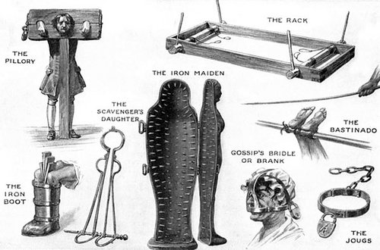

Slide 19
Game engines?
Phaser, Game Closure, Goo, Impact,
Quintus, Enchant, Panda, Grapefruit, MelonJS, Turbulenz, Play Canvas, Game Maker, Construct2, Spell, CreateJS, Kiwi Cocos2D-X, Crafty, LimeJS, FrozenJS…
* forever

Slide 20
Choice Paralysis

Slide 21
Which way?
The low road:
Code everything from scratch
The middle road:
Code most things from scratch
The high road:
Use a game engine

Slide 22
The middle road
Write most of your code from scratch. Drop in a third-party library for any highly specialized code when it stops becoming fun, educational or productive.
This is the best long-term strategy for developing a deep understanding of the art of game design.

Slide 23
Now we can start making things!

Slide 24
But what?
Make a drawing surface.
Draw lines, shapes and images.
Turn them into reusable components called Sprites.
Make the sprites interactive.

Slide 25
Make a canvas
var canvas = document.createElement("canvas");
canvas.width = 512;
canvas.height = 512;
canvas.style.border = "1px dashed black";
document.body.appendChild(canvas);
var ctx = canvas.getContext("2d");
<canvas id=“canvas" width=“256” height=“256”></canvas>

Slide 26


Slide 27
Draw a line
//1. Set the line style options
ctx.strokeStyle = "black";
ctx.lineWidth = 3;
//2. Draw the line
ctx.beginPath();
ctx.moveTo(0, 0);
ctx.lineTo(128, 128);
ctx.closePath();
ctx.stroke();

Slide 28
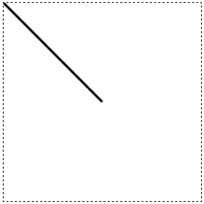

Slide 29
Connect lines
//Set the line and fill style options
ctx.strokeStyle = "black";
ctx.lineWidth = 3;
ctx.fillStyle = "rgba(128, 128, 128, 0.5)";
//Connect lines together to form a
//triangle in the center of the canvas
ctx.beginPath();
ctx.moveTo(128, 85);
ctx.lineTo(170, 170);
ctx.lineTo(85, 170);
ctx.lineTo(128, 85);
ctx.closePath();
ctx.stroke();
ctx.fill();

Slide 30
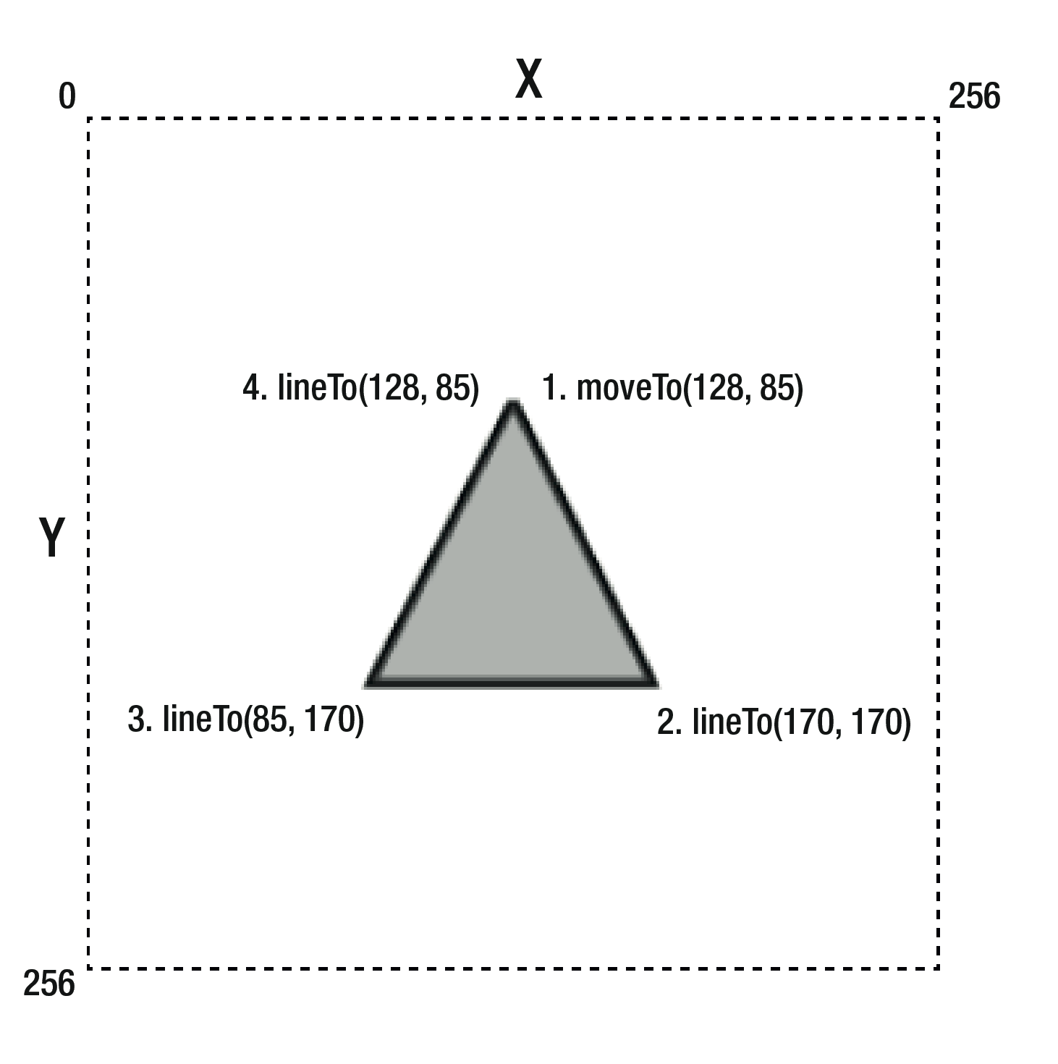

Slide 31
Shapes
//1. Define the shape
var triangle = [
[128, 85],
[170, 170],
[85, 170]
];
//2. Plot the lines
function drawPath(shape) {
//Start drawing from the last point
var lastPoint = shape.length - 1;
ctx.moveTo(
shape[lastPoint][0],
shape[lastPoint][1]
);
//Use a loop to plot each point
shape.forEach(function(point) {
ctx.lineTo(point[0], point[1]);
});
}
//3. Draw the shape
ctx.beginPath();
drawPath(triangle);
ctx.stroke();
ctx.closePath();
ctx.fill();

Slide 32
Rectangles
//Set the line and fill style options
ctx.strokeStyle = "black";
ctx.lineWidth = 3;
ctx.fillStyle = "rgba(128, 128, 128, 0.5)";
//Draw the rectangle
ctx.beginPath();
ctx.rect(50, 40, 70, 90);
ctx.stroke();
ctx.closePath();
ctx.fill();

Slide 33
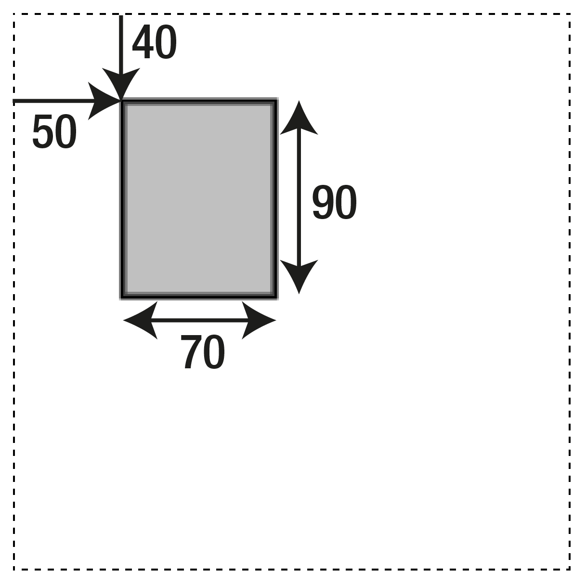
ctx.rect(50, 40, 70, 90);

Slide 34
Circles
arc(centerX, centerY, circleRadius, startAngle, endAngle, false)
//Set the line and fill style options
ctx.strokeStyle = "black";
ctx.lineWidth = 3;
ctx.fillStyle = "gray";
//Draw the circle
ctx.beginPath();
ctx.arc(128, 128, 64, 0, 2*Math.PI, false);
ctx.closePath();
ctx.stroke();
ctx.fill();

Slide 35
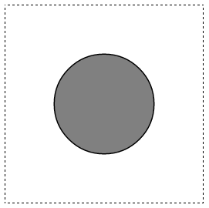
ctx.arc(128, 128, 64, 0, 2*Math.PI, false)

Slide 36
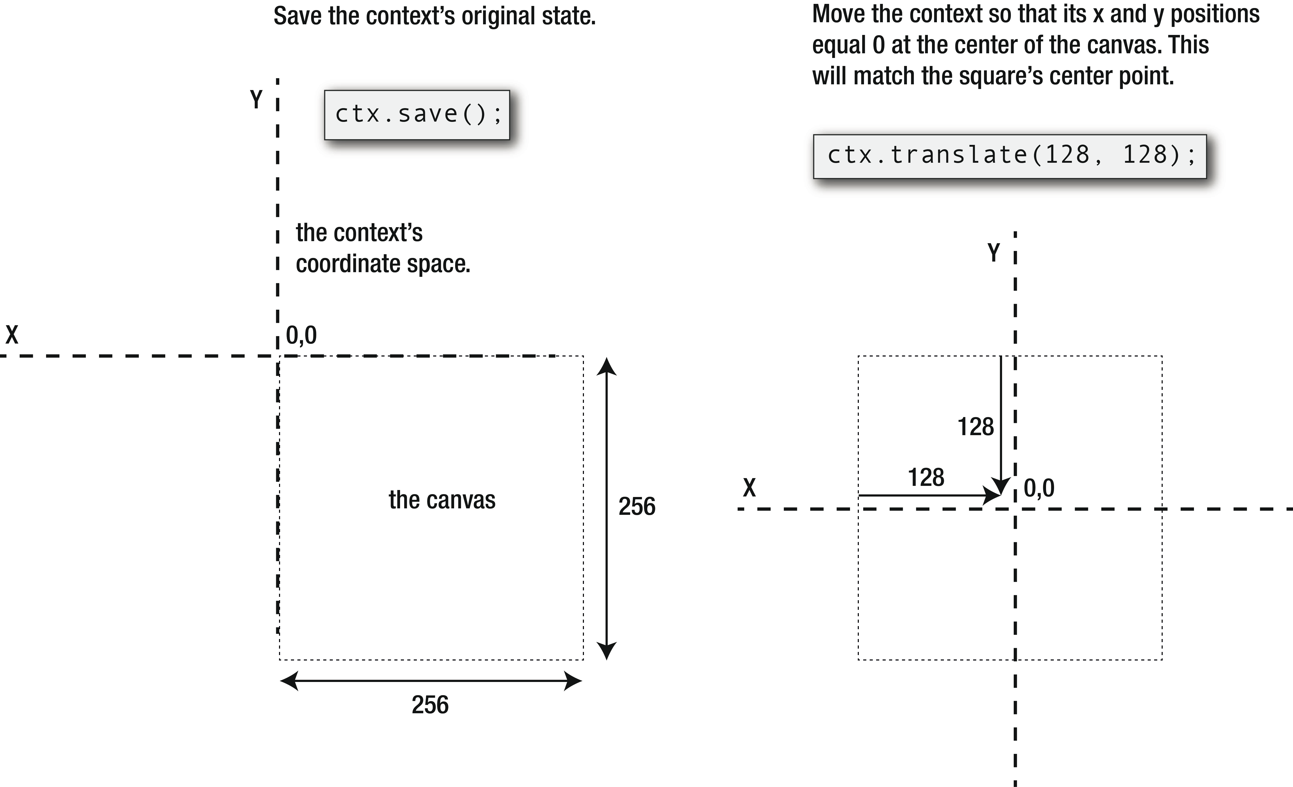
Rotation

Slide 37
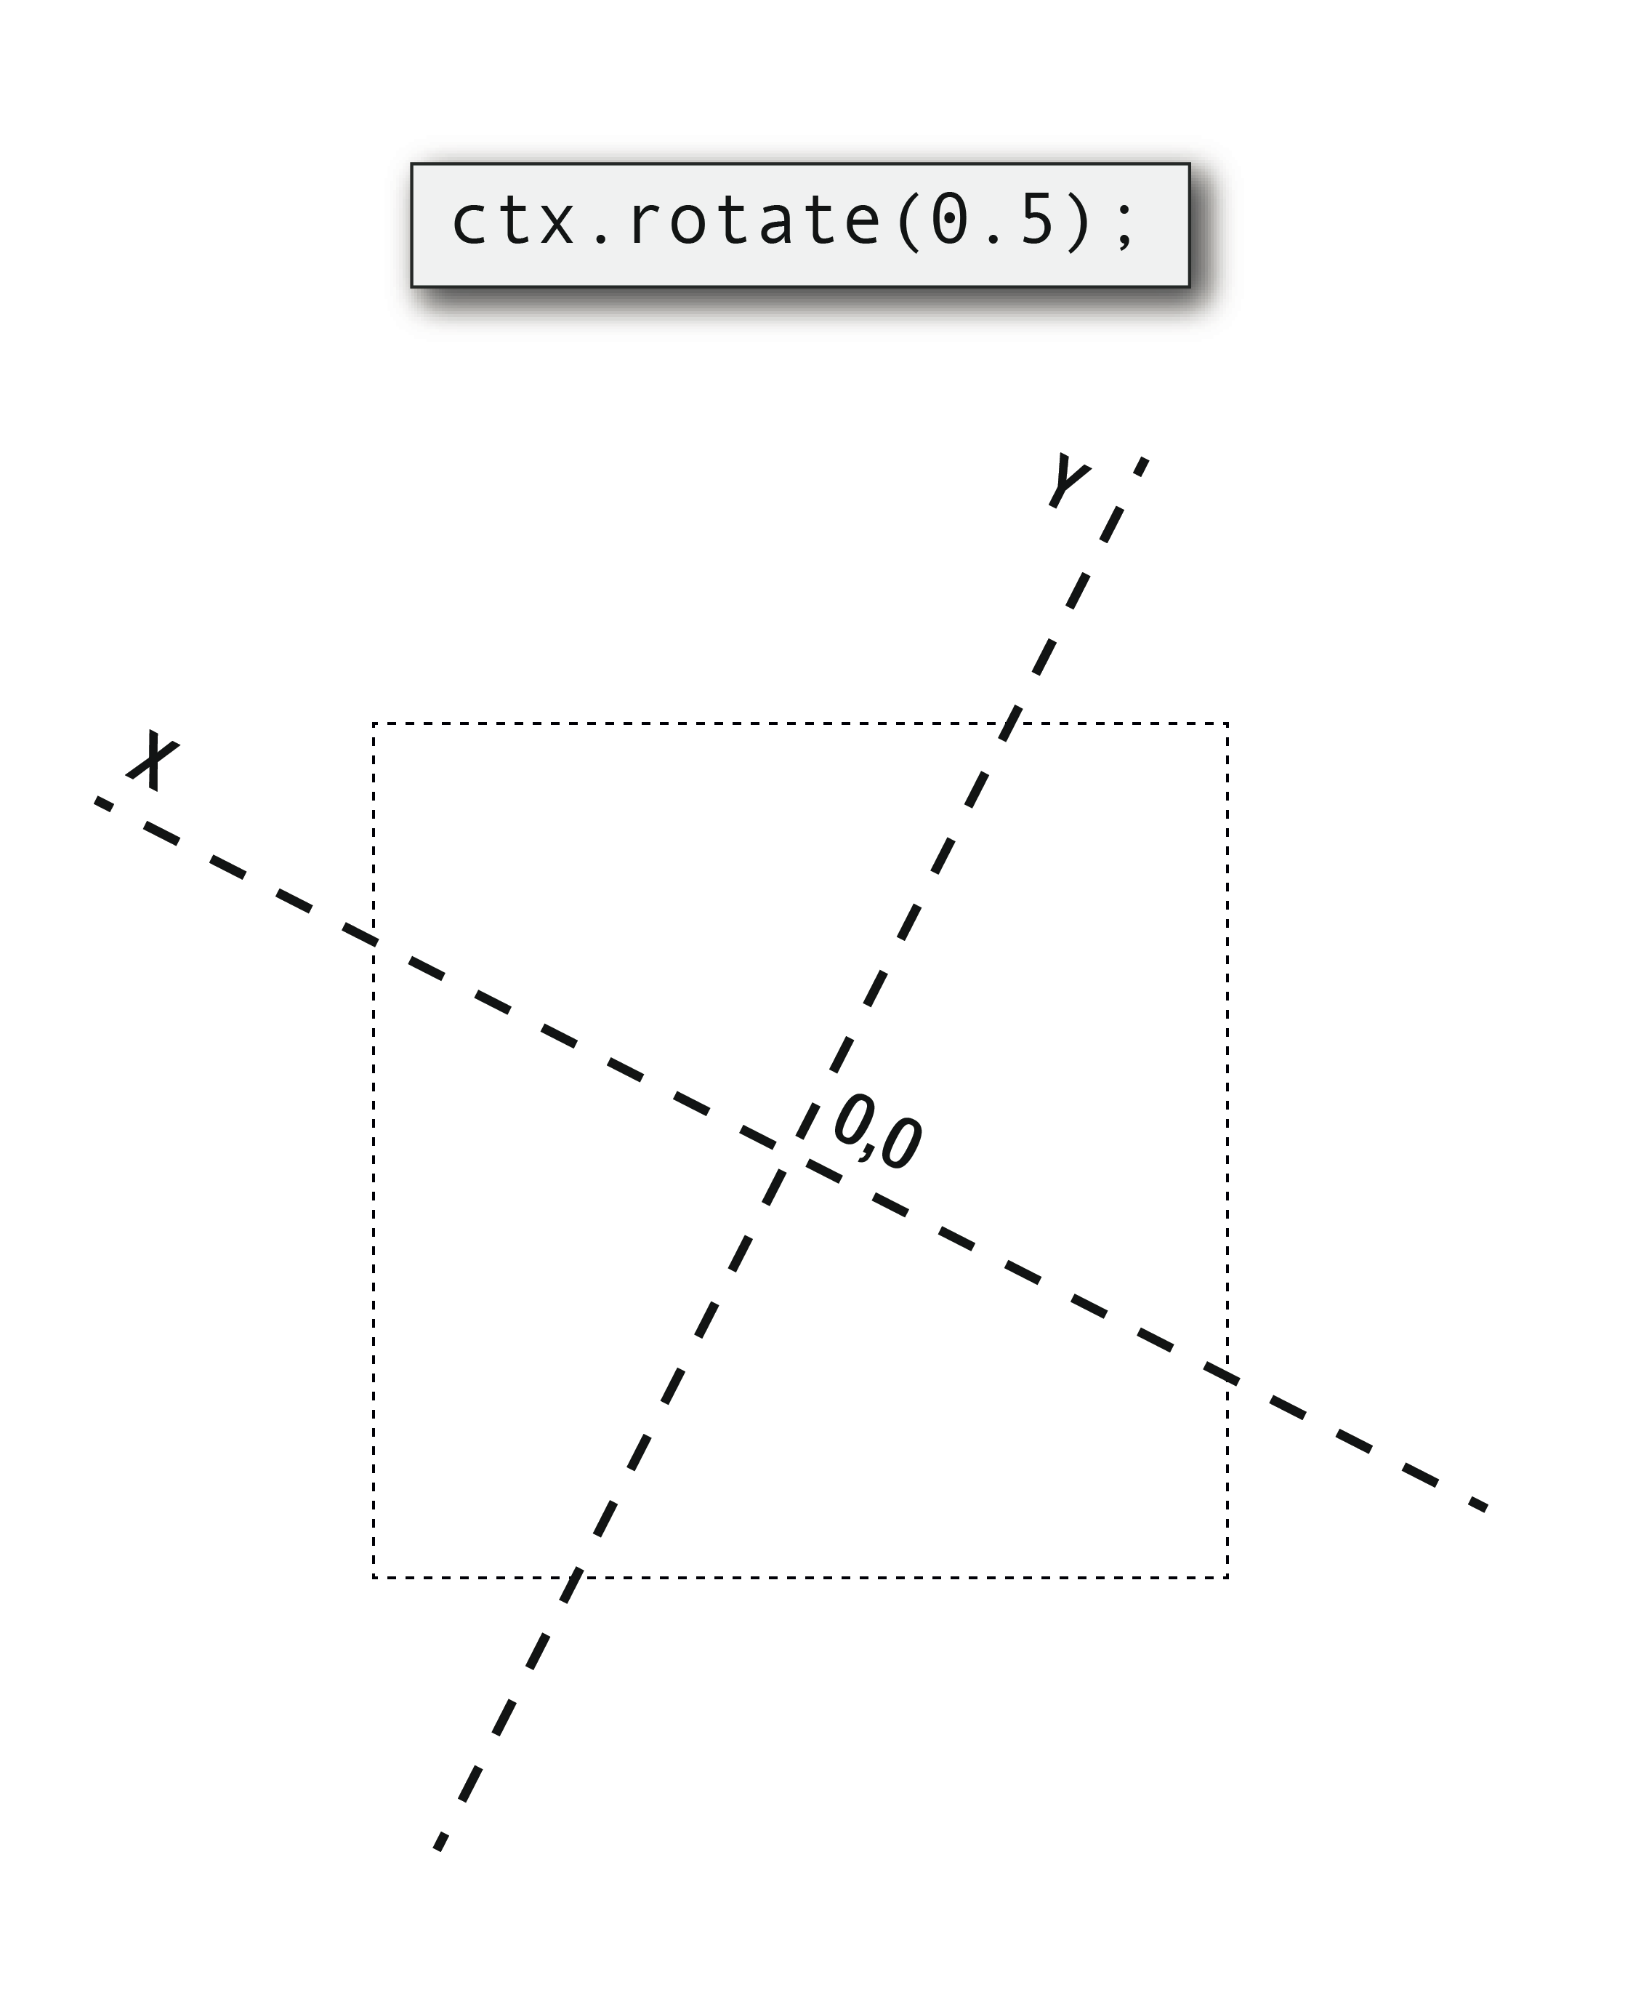

Slide 38
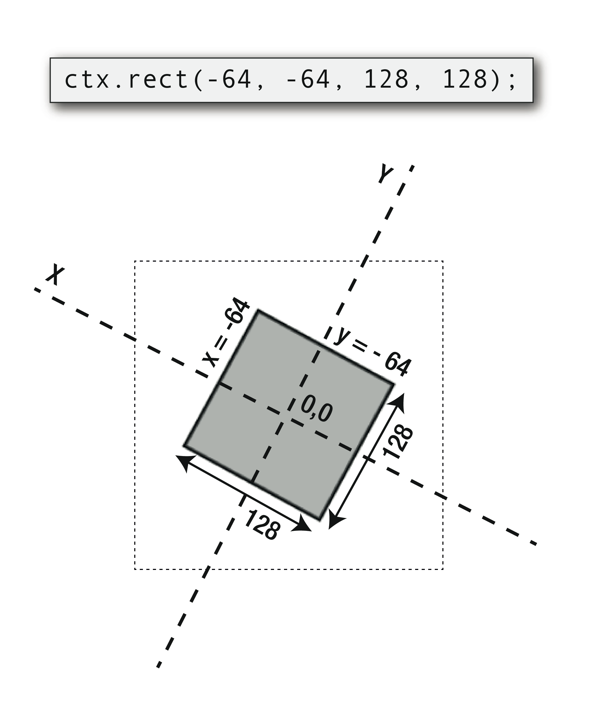

Slide 39
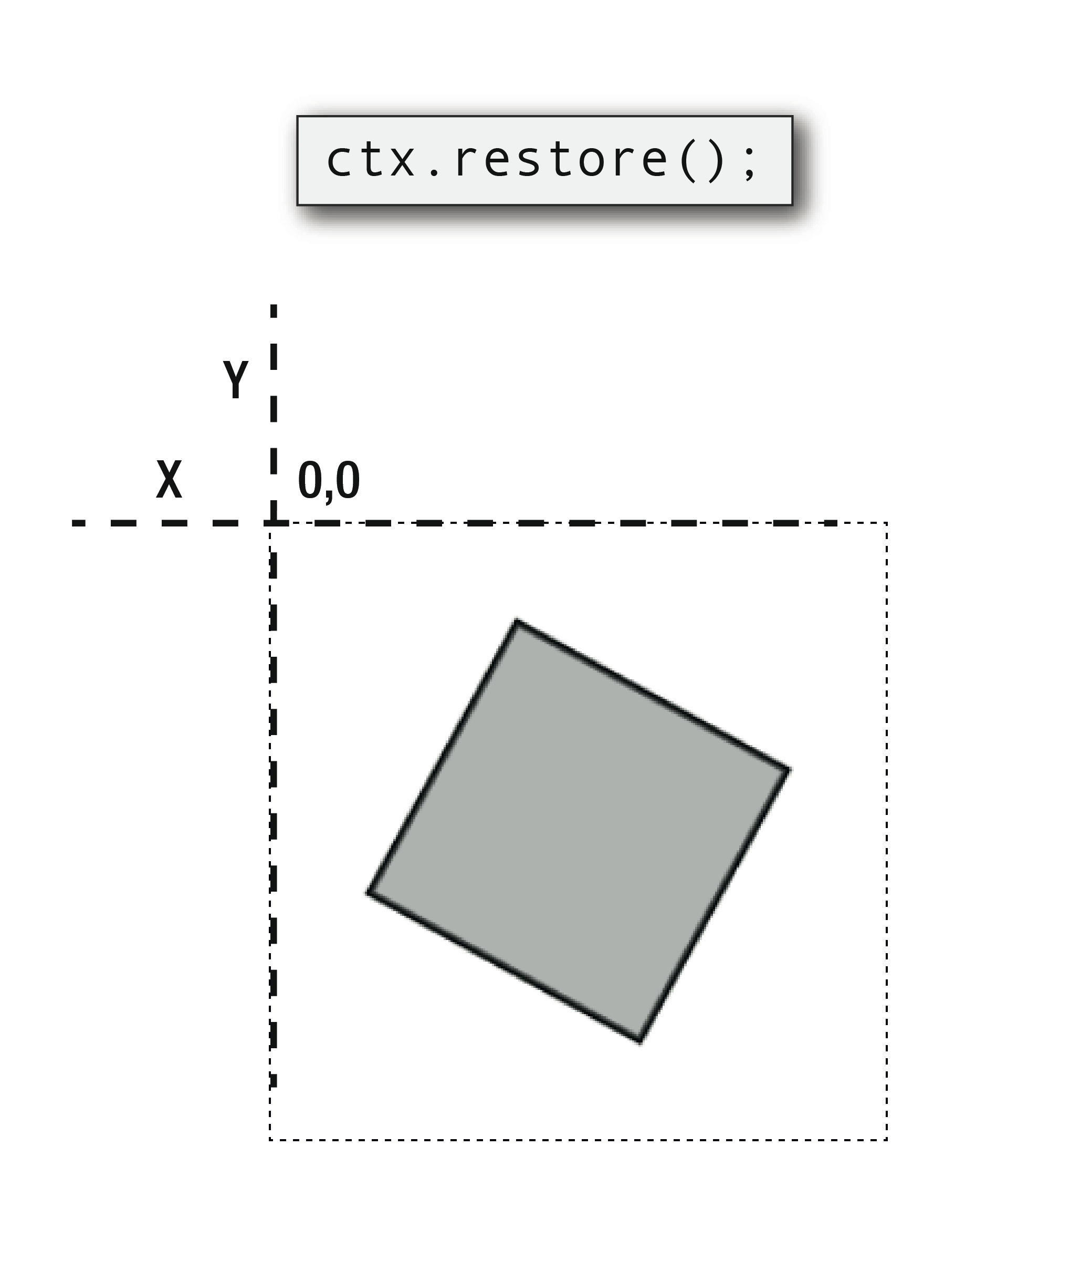

Slide 40
//Set the line and fill style options
ctx.strokeStyle = "black";
ctx.lineWidth = 3;
ctx.fillStyle = "rgba(128, 128, 128, 0.5)";
//Save the current state of the drawing context before it's rotated
ctx.save();
//Shift the drawing context's 0,0 point from the canvas's top left
//corner to the center of the canvas. This will be the
//square's center point
ctx.translate(128, 128);
//Rotate the drawing context's coordinate system 0.5 radians
ctx.rotate(0.5);
//Draw the square from -64 x and -64 y. That will mean its center
//point will be at exactly 0, which is also the center of the
//context's coordinate system
ctx.beginPath();
ctx.rect(-64, -64, 128, 128);
ctx.closePath();
ctx.stroke();
ctx.fill();
//Restore the drawing context to
//its original position and rotation
ctx.restore();

Slide 41
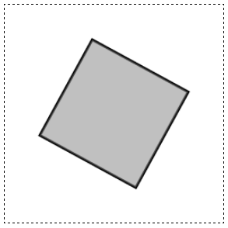

Slide 42
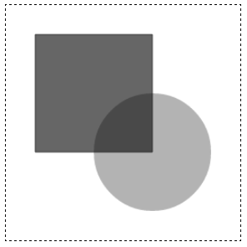
Transparency
//Set the fill style options
ctx.fillStyle = "black";
//Draw the rectangle
ctx.save();
ctx.beginPath();
ctx.globalAlpha = 0.6;
ctx.rect(32, 32, 128, 128);
ctx.stroke();
ctx.fill();
ctx.restore();
//Draw the circle
ctx.save();
ctx.beginPath();
ctx.globalAlpha = 0.3;
ctx.arc(160, 160, 64, 0, 6.28, false)
ctx.fill();
ctx.restore();

Slide 43
Display an image
ctx.drawImage(imageObject, xPosition, yPosition);
//Load an image
var catImage = new Image();
catImage.addEventListener("load", loadHandler, false);
catImage.src = "images/cat.png";
//The loadHandler is called when the image has loaded
function loadHandler() {
ctx.drawImage(catImage, 64, 64);
}

Slide 44


Slide 45
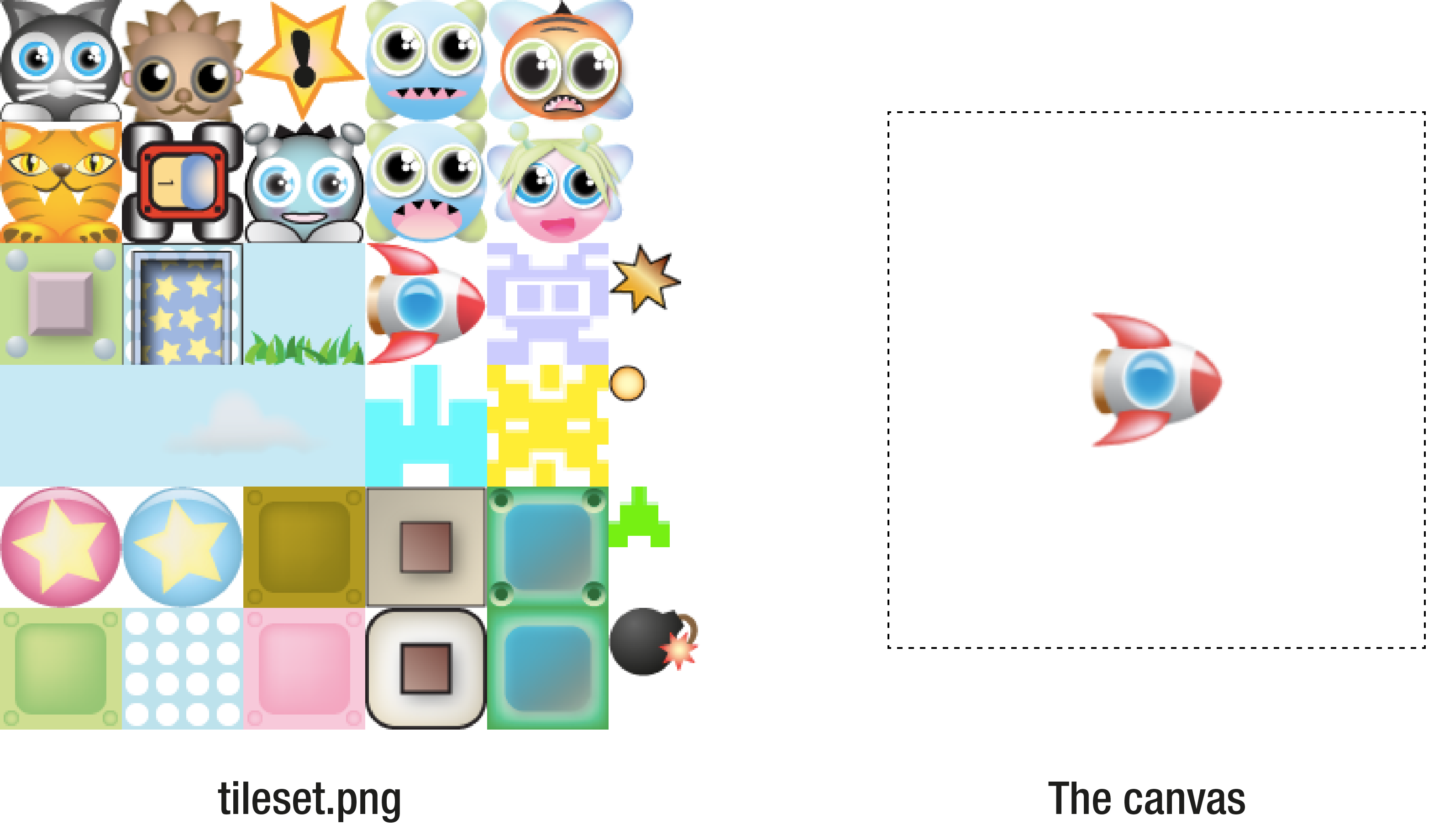
Blitting

Slide 46
//Load the tileset image
var tileset = new Image();
tileset.addEventListener("load", loadHandler, false);
tileset.src = "images/tileset.png";
//The loadHandler is called when the image has loaded
function loadHandler() {
ctx.drawImage(
tileset, //The image file
192, 128, //The source x and y position
64, 64, //The source height and width
96, 96, //The destination x and y position
64, 64 //The destination height and width
);
}

Slide 47
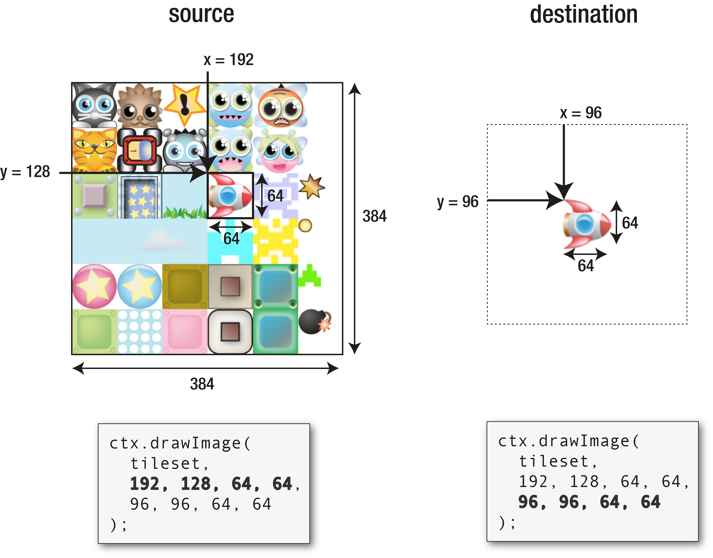

Slide 48
Text
//Create a text string defines the content you want to display
var content = "Hello World!";
//Assign the font to the canvas context
ctx.font = "24px 'Rockwell Extra Bold', 'Futura', sans-serif";
//Set the font color to red
ctx.fillStyle = "red";
//Figure out the width and height of the text
var width = ctx.measureText(content).width,
height = ctx.measureText("M").width;
//Set the text's x/y registration point to its top left corner
ctx.textBaseline = "top";
//Use `fillText` to Draw the text in the center of the canvas
ctx.fillText(
content, //The text string
canvas.width / 2 - width / 2, //The x position
canvas.height / 2 - height / 2 //The y position
);

Slide 49


Slide 50
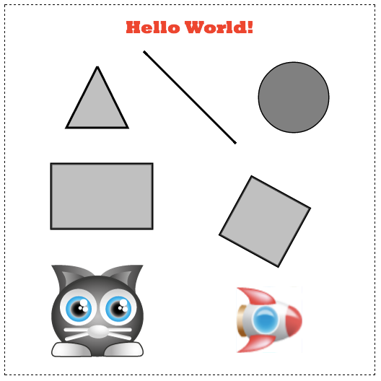
examples/canvasPlayground.html

Slide 51
More canvas stuff
Scale
Blend modes
Compositing
Shadows
Curves

Slide 52
You can’t make a game like this.
The code will crumble in your hands.

Slide 53
Then how?

Slide 54
Sprites
The LEGO bricks of game design.
Make sprites using canvas components.
Snap sprites together to make a game.

Slide 55
Making sprites
1. An array to store all the game sprites
var sprites = [];

Slide 56
1. A function that returns a sprite object
function sprite (property) {
//Create an object
var o = {};
//...Assign properties to the object
//that refer to canvas properties…
o.property = property;
//Add a `render` method that explains how to draw the sprite
o.render = function(ctx) {
//...canvas drawing operations...
};
//Push the sprite object into the `sprites` array
sprites.push(o);
//Return the object
return o;
}

Slide 57
2. A function to render the sprite on the canvas
function render() {
//Clear the canvas
ctx.clearRect(0, 0, canvas.width, canvas.height);
//Loop through each sprite in the sprites array
sprites.forEach(function(sprite){
//Save the canvas state
ctx.save();
//Shift the canvas to the sprite's position and set
//Rotation, alpha and scale values
//Use the sprite's own `render` method to draw the sprite
sprite.render(ctx);
//Restore the canvas state before rendering the next sprite
ctx.restore();
});
}

Slide 58
3. Make a sprite and render it
var newSprite = sprite(“propertyValue”);
render();

Slide 59
1. Make a rectangle sprite function
var rectangle = function(width, height, fillStyle, strokeStyle, lineWidth) {
//Create an object
var o = {};
//Assign properties to the object that refer to canvas properties
o.x = 0;
o.y = 0;
o.width = width;
o.height = height;
o.fillStyle = fillStyle;
o.strokeStyle = strokeStyle;
o.lineWidth = lineWidth;
//Optional rotation and alpha
o.rotation = 0;
o.alpha = 1;
//Add `vx` and `vy` (velocity) variables that will help us move the sprite
o.vx = 0;
o.vy = 0;
//Add a `render` method that explains how to draw the sprite
o.render = function(ctx) {
ctx.strokeStyle = o.strokeStyle;
ctx.lineWidth = o.lineWidth;
ctx.fillStyle = o.fillStyle;
ctx.beginPath();
ctx.rect(-o.width / 2, -o.height / 2, o.width, o.height);
ctx.closePath();
ctx.stroke();
ctx.fill();
};
//Push the sprite object into the `sprites` array
sprites.push(o);
//Return the object
return o;
};

Slide 60
2. A function to render sprites
function render() {
//Clear the canvas
ctx.clearRect(0, 0, canvas.width, canvas.height);
//Loop through all the sprites in the `sprites` array
sprites.forEach(function(sprite){
//Save the canvas context’s current state
ctx.save();
//Shift the canvas to the sprite's position
ctx.translate(
sprite.x + sprite.width / 2,
sprite.y + sprite.height /2
);
//Set the sprite's `rotation` and `alpha`
ctx.rotate(sprite.rotation);
ctx.globalAlpha = sprite.alpha;
//Use the sprite's own `render` method to draw the sprite
sprite.render(ctx);
//Restore the canvas for the next sprite
ctx.restore();
});
}

Slide 61
3. Make some sprites and render them
var boxOne = rectangle(128, 128, "#FFDAAB", "black", 2);
boxOne.x = 64;
boxOne.y = 64;
var boxTwo = rectangle(128, 128, "#DDFFAB", "black", 2);
boxTwo.x = 300;
boxTwo.y = 200;
var boxThree = rectangle(128, 128, "#D9ABFF", "black", 2);
boxThree.x = 64;
boxThree.y = 300;
render();

Slide 62
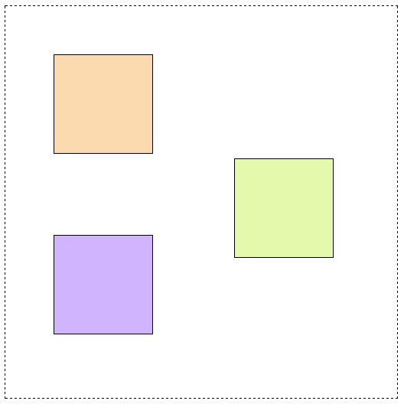

Slide 63
Moving sprites
1. Create a game loop
function gameLoop() {
//Create a loop
requestAnimationFrame(gameLoop, canvas);
//Update the game logic and render
//the sprites 60 times per second:
update();
render();
}
//Start the game loop
gameLoop();

Slide 64
2. Update the game logic and renderer
//The game logic (called 60 times per second)
function update() {
//Loop through all the sprites
sprites.forEach(function(sprite){
//a. Change the sprite's velocity in some way
//... ??? ...
//b. Add the new velocity to the sprite's current position
//to make the sprite move
sprite.x += sprite.vx;
sprite.y += sprite.vy;
});
}
//The renderer (called 60 times per second)
function render() {
//... Render all the sprites ...
}

Slide 65
Make sprites bounce off canvas edges
function update() {
sprites.forEach(function(sprite){
sprite.x += sprite.vx;
sprite.y += sprite.vy;
//Screen boundaries
//Left
if (sprite.x < 0) {
//Position the sprite inside the canvas
sprite.x = 0;
//Reverse its velocity to make it bounce
sprite.vx = -sprite.vx;
}
//Right
if (sprite.x + sprite.width > canvas.width) {
sprite.x = canvas.width - sprite.width;
sprite.vx = -sprite.vx;
}
//Top
if (sprite.y < 0) {
sprite.y = 0;
sprite.vy = -sprite.vy;
}
//Bottom
if (sprite.y + sprite.width > canvas.height) {
sprite.y = canvas.height - sprite.width;
sprite.vy = -sprite.vy;
}
});
}

Slide 66
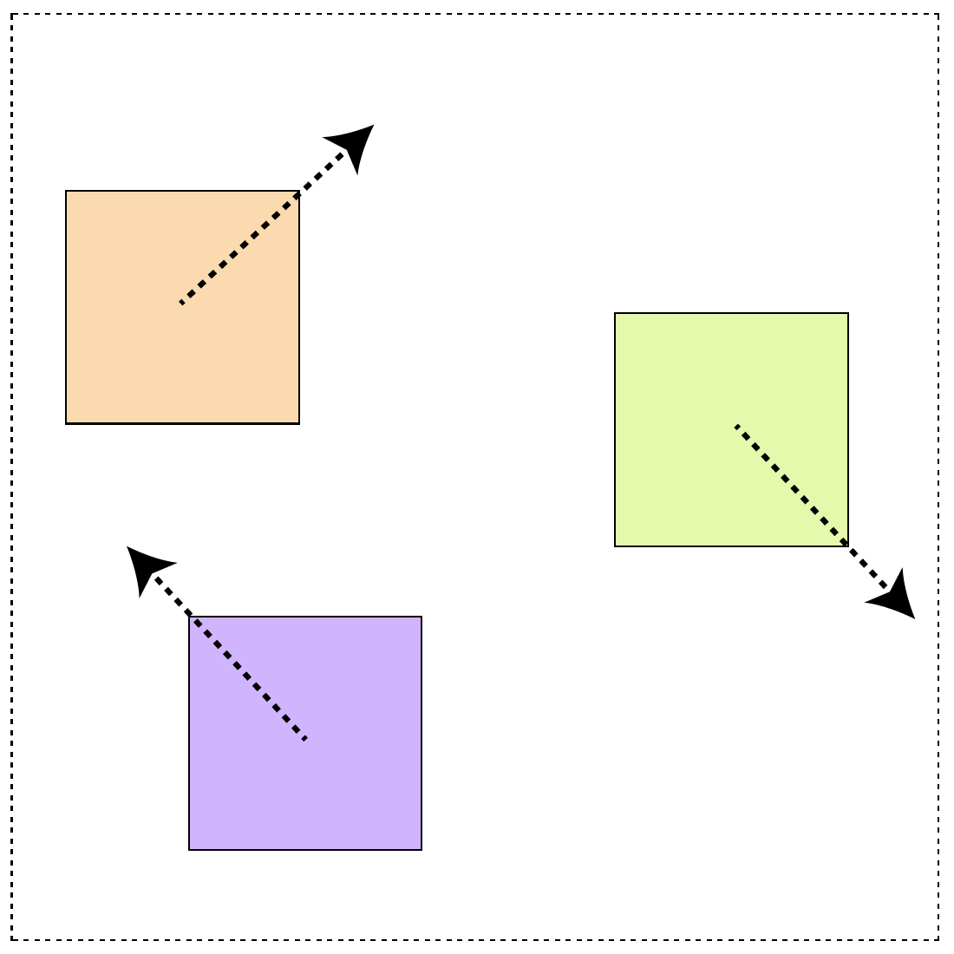

Slide 67
Interactivity
Use event listeners
window.addEventListener(“keydown", function(event) {
//do something when a key is pressed down
}, false);
window.addEventListener("keyup", function(event) {
//do something when a key is released
}, false);

Slide 68
1. Assign key codes and direction trackers.
//Arrow key codes
var UP = 38,
DOWN = 40,
RIGHT = 39,
LEFT = 37;
//Directions
var moveUp = false,
moveDown = false,
moveRight = false,
moveLeft = false;

Slide 69
2. Program the keyboard even listeners
window.addEventListener(
"keydown",
function(event) {
switch(event.keyCode){
case UP:
moveUp = true;
break;
case DOWN:
moveDown = true;
break;
case LEFT:
moveLeft = true;
break;
case RIGHT:
moveRight = true;
break;
}
},
false
);
window.addEventListener(
"keyup",
function(event) {
switch(event.keyCode){
case UP:
moveUp = false;
break;
case DOWN:
moveDown = false;
break;
case LEFT:
moveLeft = false;
break;
case RIGHT:
moveRight = false;
break;
}
},
false
);

Slide 70
3. Use the
directions to
update the sprite’s
velocity in the
game loop.
function update() {
//Up
if(moveUp && !moveDown) {
box.vy = -5;
}
//Down
if(moveDown && !moveUp) {
box.vy = 5;
}
//Left
if(moveLeft && !moveRight) {
box.vx = -5;
}
//Right
if(moveRight && !moveLeft) {
box.vx = 5;
}
//Set the box's velocity to zero if none
//of the keys are being pressed
if(!moveUp && !moveDown) {
box.vy = 0;
}
if(!moveLeft && !moveRight) {
box.vx = 0;
}
//Move the box
box.x += box.vx;
box.y += box.vy;
}

Slide 71
3. Set the screen boundaries
//Left
if (box.x < 0) {
//Position the box inside the canvas
box.x = 0;
}
//Right
if (box.x + box.width > canvas.width) {
box.x = canvas.width - box.width;
}
//Top
if (box.y < 0) {
box.y = 0;
}
//Bottom
if (box.y + box.width > canvas.height) {
box.y = canvas.height - box.width;
}

Slide 72
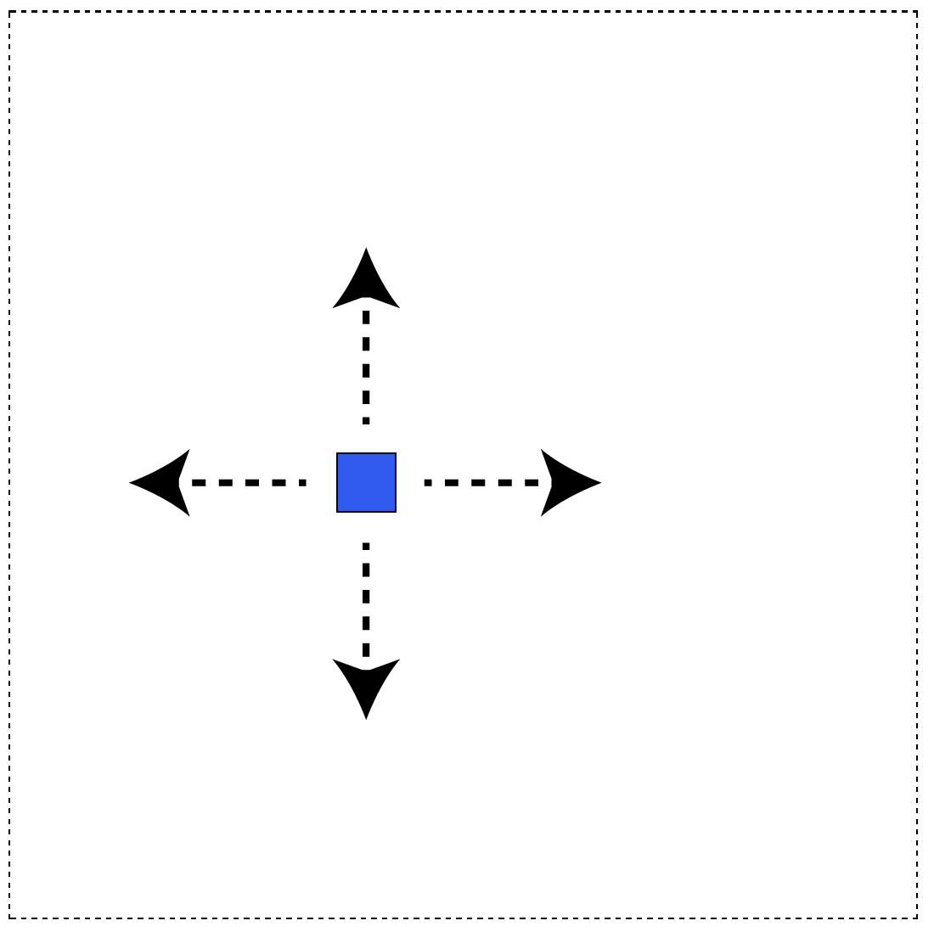

Slide 73
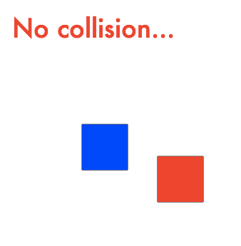
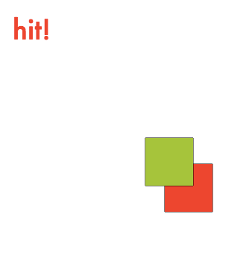
Collision detection
Check whether rectangles are overlapping

Slide 74
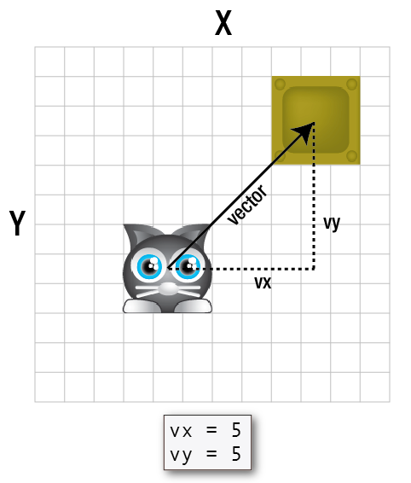
1. Figure out the vector.

Slide 75
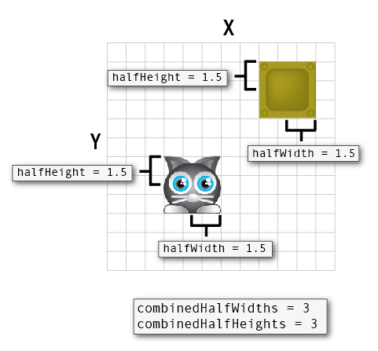
2. Figure out the combined half-widths
and half-heights.

Slide 76
If the combined half-widths and
half-heights are less than the vx and vy
variables, then the sprites are touching.

Slide 77
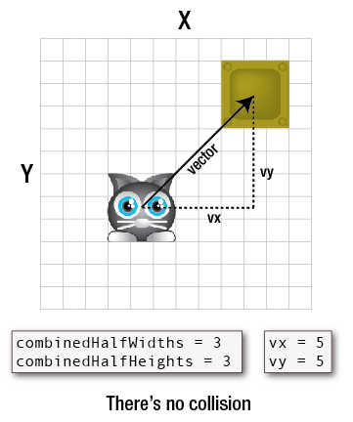

Slide 78
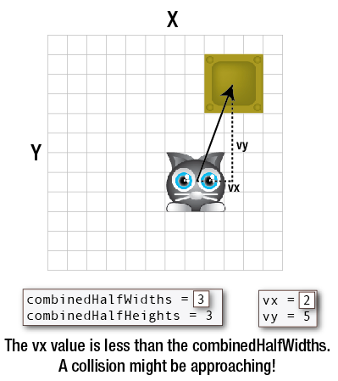

Slide 79
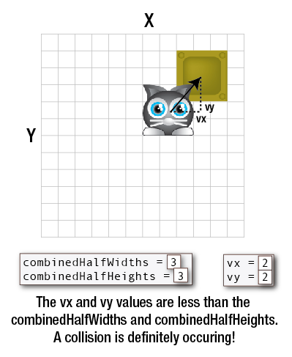

Slide 80
The code: `hitTestRectangle`
function hitTestRectangle(r1, r2) {
//Find the half-width values and center x/y points of two rectangles
r1.halfWidth = r1.width / 2;
r1.halfHeight = r1.height / 2;
r1.centerX = r1.x + r1.halfWidth;
r1.centerY = r1.y + r1.halfHeight;
r2.halfWidth = r2.width / 2;
r2.halfHeight = r2.height / 2;
r2.centerX = r2.x + r2.halfWidth;
r2.centerY = r2.y + r2.halfHeight;
//A variable to determine whether there's a collision
var hit = false;
//Calculate the distance vector
var vx = r1.centerX - r2.centerX;
var vy = r1.centerY - r2.centerY;
//Figure out the combined half-widths and half-heights
var combinedHalfWidths = r1.halfWidth + r2.halfWidth;
var combinedHalfHeights = r1.halfHeight + r2.halfHeight;
//Check for a collision on the x axis
if(Math.abs(vx) < combinedHalfWidths) {
//A collision might be occurring. Check for a collision on the y axis
if(Math.abs(vy) < combinedHalfHeights) {
//There's definitely a collision happening
hit = true;
}
else {
//There's no collision on the y axis
hit = false;
}
}
else {
//There's no collision on the x axis
hit = false;
}
return hit;
}

Slide 81
Use `hitTestRectangle` like this:
if(hitTestRectangle(rectangleOne, rectangleTwo)) {
//Collision!
} else {
//No collision.
}

Slide 82
if(hitTestRectangle(blueBox, redBox)) {
message.content = "hit!"
blueBox.fillStyle = "yellowGreen";
} else {
message.content = "No collision...";
blueBox.fillStyle = "blue";
}

Slide 83
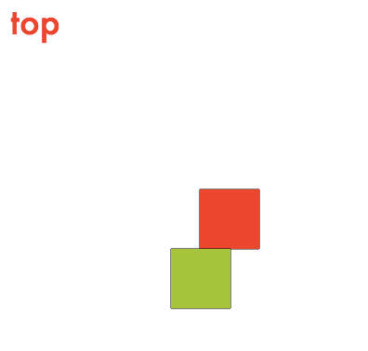
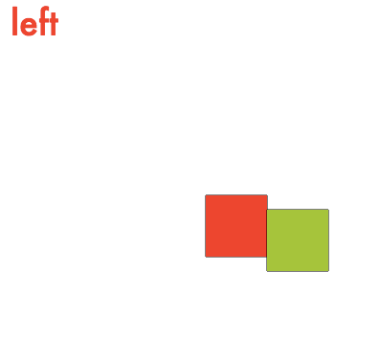
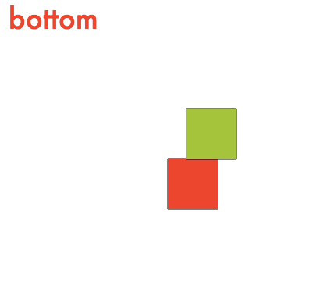
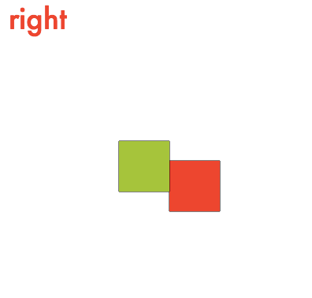
Preventing overlaps

Slide 84
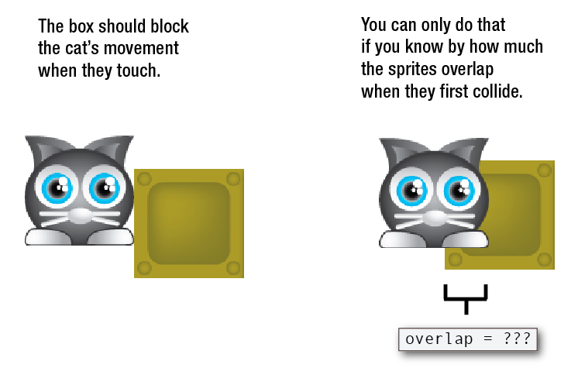

Slide 85
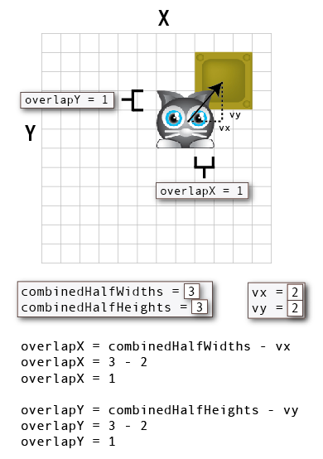

Slide 86
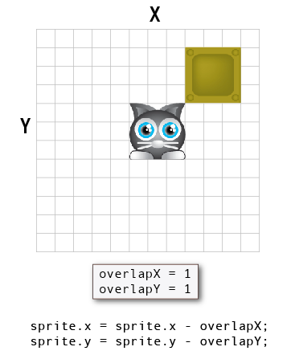

Slide 87
//Check whether vx is less than the combined half widths
if (Math.abs(vx) < combinedHalfWidths) {
//Check whether vy is less than the combined half heights
if (Math.abs(vy) < combinedHalfHeights) {
//A collision is occurring! Calculate the overlap
overlapX = combinedHalfWidths - Math.abs(vx);
overlapY = combinedHalfHeights - Math.abs(vy);
//The collision has occurred on the axis with the
//*smallest* amount of overlap.
if (overlapX >= overlapY) {
if (vy > 0) {
collision = "top";
r1.y = r1.y + overlapY;
} else {
collision = "bottom";
r1.y = r1.y - overlapY;
}
//Bounce
if (bounce) {
r1.vy *= -1;
}
} else {
if (vx > 0) {
collision = "left";
r1.x = r1.x + overlapX;
} else {
collision = "right";
r1.x = r1.x - overlapX;
}
//Bounce
if (bounce) {
r1.vx *= -1;
}
}
} else {
//No collision
}
} else {
//No collision
}
//Return the collision string. it will be either "top", "right",
//"bottom", or "left" depending on which side of r1 is touching r2.
return collision;

Slide 88
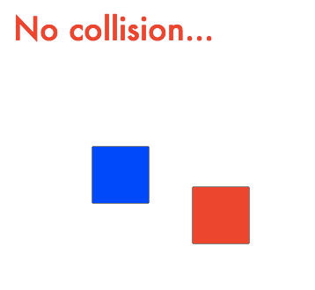
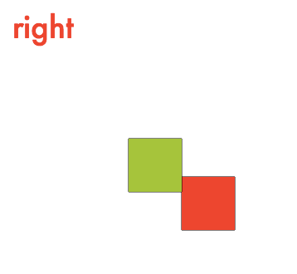
var collision = rectangleCollision(blueBox, redBox);
if (collision) {
message.content = collision;
blueBox.fillStyle = "yellowGreen";
}
else {
message.content = "No collision...";
blueBox.fillStyle = "blue";
}

Slide 89
Playing sounds
With the HTML Audio element…?
var sound = new Audio(); sound.addEventListener(
"canplaythrough", playSoundHandler, false
); sound.src = "sounds/music.wav"; function playSoundHandler(event) { sound.play(); sound.volume = 0.5; sound.loop = true; }

Slide 90
Imprecise playback control
Latencty
No concurrency without dodgy hacks
Quirky browser implementations

Slide 91
Web Audio API
Extremely powerful, low-level control over sounds.

Slide 93
“Web Audio API”
by Boris Smus

Slide 94
But!
You have to write about 20 lines of
code just to play a single sound…

Slide 95
//1. Create an audio context
var actx = new AudioContext();
//2. Declare a variable to hold the sound we'll load
var soundBuffer;
//3. Load the sound
//a. Use an XMLHttpRequest object to load the sound
var xhr = new XMLHttpRequest();
//b. Set properties for the file we want to load.
//Use GET and set the path to the sound file.
//`true` means that the file will load
//asynchronously and will create an event when the
//file has finished loading
xhr.open("GET", "sounds/shoot.wav", true);
//c. Set the `responseType`, which is the file format
//we’re expecting to load. Sound files should
//be loaded as binary files, so the responseType
//needs to be `arraybuffer`
xhr.responseType = "arraybuffer";
//d. Load the sound into the program
xhr.send();
//e. Create a `loadHandler` that runs when
//the sound has been loaded
xhr.addEventListener("load", loadHandler, false);
function loadHandler(event) {
//console.log("music loaded")
//f. Decode the audio file and store it in a
//the `music` sound variable. The `buffer` is the
//raw audio data
actx.decodeAudioData(
xhr.response,
function(buffer) {
//g. Copy the audio file into the
//`soundBuffer` variable
soundBuffer = buffer;
},
//Optionally throw an error
function(error) {
throw new Error("Audio could not be decoded: " + error);
}
);
}
//f. Play a sound when a key is pressed
window.addEventListener("keydown", keydownHandler, false);
function keydownHandler(event) {
switch (event.keyCode) {
case 49:
/*
//4. Play the sound (without volume and pan control)
//a. Create a new `soundNode` variable and tell
//it to use the sound that we loaded as its audio source
var soundNode = actx.createBufferSource();
soundNode.buffer = soundBuffer;
//b. Connect the sound to the desination
soundNode.connect(actx.destination);
//c. Finally, actually play the sound. Use the
//`start` method to set the sound's start position time to
//0 (the beginning of the sound)
soundNode.start(0);
*/
//4. Play the sound (with volume, pan and loop)
var soundNode = actx.createBufferSource();
soundNode.buffer = soundBuffer;
//Create volume and pan nodes
var volumeNode = actx.createGain();
var panNode = actx.createPanner();
//Connect the sound source to the pan node, the pan node to
//volume node, and the volume node to the destination
soundNode.connect(panNode);
panNode.connect(volumeNode);
volumeNode.connect(actx.destination);
//Set the volume
volumeNode.gain.value = 0.5;
//Set left/right panning
var x = -1,
y = 0,
z = 1 - Math.abs(x);
panNode.setPosition(x, y, z);
panNode.panningModel = "equalpower";
//Optionally loop the sound
//soundNode.loop = true;
//Finaly, play the sound
soundNode.start(0);
break;
}
}

Slide 96
And you have to do this every time
you want to play the sound.

Slide 97
Abstract it
Spend and afternoon writing your own high level API wrapper so that you can make easy-to-use sound sprites.
Use someone else’s wrapper: Howler, Theresa’s Sound World, or WAD.

Slide 98
`makeSound`
A function that uses the Web Audio API
to create sound sprites.
//Define the audio context
window.AudioContext = window.AudioContext || window.webkitAudioContext;
var actx = new AudioContext();
//Create the sound
var shoot = makeSound("sounds/shoot.wav", actx, soundLoadHandler);
//An optional callback that runs when the sound is loaded
function soundLoadHandler() {
console.log("sound loaded");
}
//A keyboard event listener that plays the sound when
/the `1` key is pressed is pressed
window.addEventListener("keydown", function(event) {
if(event.keyCode === 49) {
//Play the sound
shoot.play();
}
}, false);

Slide 99
Now you can start making games!

Slide 100
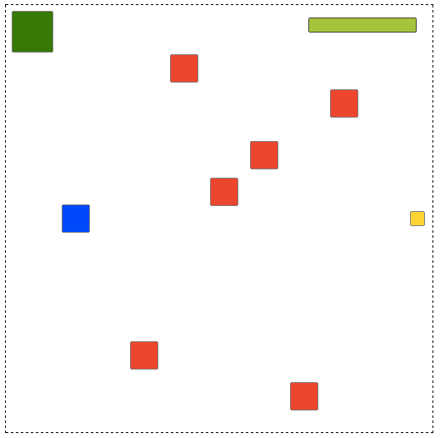
Treasure Hunter

Slide 101
Treasure Hunter
Everything a complete game needs:
Sprites
An update/render loop
Interactivity
Collision
Game states
“juice” (sound)

Slide 102
Make the enemies
var numberOfEnemies = 6,
spacing = 48,
xOffset = 150,
speed = 2,
direction = 1,
enemies = [];
//Make as many enemies as there are `numberOfEnemies`
for (var i = 0; i < numberOfEnemies; i++) {
//Each enemy is a red rectangle
var enemy = rectangle(32, 32, "red");
//Space each enemy horizontally according to the `spacing` value.
//`xOffset` determines the point from the left of the screen
//at which the first enemy should be added.
var x = spacing * i + xOffset;
//Give the enemy a random y position
var y = random(0, canvas.height - enemy.height);
//Set the enemy's position
enemy.x = x;
enemy.y = y;
//Set the enemy's vertical velocity. `direction` will be either `1` or
//`-1`. `1` means the enemy will move down and `-1` means the enemy will
//move up. Multiplying `direction` by `speed` determine's the enemy's
//vertical direction
enemy.vy = speed * direction;
//Reverse the direction for the next enemy
direction *= -1;
//Push the enemy into the `enemies` array
enemies.push(enemy);
}

Slide 103

Make the health bar
var outerBar = rectangle(128, 16, "black"),
innerBar = rectangle(128, 16, "yellowGreen");
innerBar.x = outerBar.x = canvas.width - 148;
innerBar.y = outerBar.y = 16;

Slide 104
Set the game state
//Set the `state` function to `play`
var state = play;
//Start the game loop
gameLoop();
function gameLoop() {
requestAnimationFrame(gameLoop, canvas);
//Update the current game state
state();
//Render the sprites
render();
}
function play() {
//The main game logic
}
function end() {
//What should happen when the game ends
}

Slide 105
Collision between the player and enemies
//Set `playerHit` to `false` before checking for a collision
var playerHit = false;
//Loop through all the enemies
enemies.forEach(function(enemy) {
//Move the enemy
enemy.y += enemy.vy;
//Check the enemy’s screen boundaries
checkScreenBoundaries(enemy, true);
//Test for a collision. If any of the enemies are touching
//the player, set `playerHit` to `true`
if(hitTestRectangle(player, enemy)) {
playerHit = true;
}
});
//If the player is hit...
if(playerHit) {
//Make the player semitransparent
player.alpha = 0.5;
//Reduce the width of the health bar's inner rectangle by 1 pixel
innerBar.width -= 1;
} else {
//Make the player fully opaque (non-transparent) if it hasn't been hit
player.alpha = 1;
}

Slide 106
Collision between the player and the treasure
//Create the `chimes` sound
var actx = new AudioContext();
var chimes = makeSound("sounds/chimes.wav", actx);
//Create the treasure
var treasure = rectangle(16, 16, "gold");
//Position it next to the left edge of the canvas
treasure.x = canvas.width - treasure.width - 10;
treasure.y = canvas.height / 2 - treasure.height / 2;
//Create a `pickedUp` property on the treasure to help us Figure
//out whether or not the treasure has been picked up by the player
treasure.pickedUp = false;
//Check for a collision between the player and the treasure
if (hitTestRectangle(player, treasure)) {
//If the treasure is touching the player, center it over the player
treasure.x = player.x + 8;
treasure.y = player.y + 8;
if(!treasure.pickedUp) {
//If the treasure hasn't already been picked up,
//play the `chimes` sound
chimes.play();
treasure.pickedUp = true;
};
}

Slide 107
Checking for the end of the game
//Does the player have enough health? If the width of the `innerBar`
//is less than zero, end the game and display "You lost!"
if (innerBar.width < 0) {
state = end;
message.content = "You lost!";
}
//If the player has brought the treasure to the exit,
//end the game and display "You won!"
if (hitTestRectangle(treasure, exit)) {
state = end;
message.content = "You won!";
}
function end() {
//Make all the game sprites invisible and display
//the game over message
sprites.forEach(function(sprite) {
sprite.visible = false;
});
//Display the game over message
message.visible = true;
}

Slide 108
Everything is understandable and under your complete control.

Slide 109
Too much work!

Slide 110
Out of the bosom of the Air,
Out of the cloud-folds of her garments shaken,
Over the woodlands brown and bare,
Over the harvest-fields forsaken,
Silent, and soft, and slow
Descends the snow.
Even as our cloudy fancies take
Suddenly shape in some divine expression,
Even as the troubled heart doth make
In the white countenance confession,
The troubled sky reveals
The grief it feels.
This is the poem of the air,
Slowly in silent syllables recorded;
This is the secret of despair,
Long in its cloudy bosom hoarded,
Now whispered and revealed
To wood and field.
- Henry Longfellow (1807–1882)

Slide 111
No sky
no earth - but still
snowflakes fall.
- Kajiwara Hashin (1864-?)

Slide 112
“Haiku”
Abstract and Simplify
Figure out which code you’re using over and over.
Abstract it into reusable objects and functions.
Enhance the readability of your game code and reduce your mental overhead.
Apply to: Sprites, game loop, bounds checking, preloading, environment configuration, collision, interactivity (keyboard and pointer objects), game state management, special objects like sounds, special functions like building game worlds.

Slide 113
`Ga`
A minimalist game engine for learning
<!doctype html>
<meta charset="utf-8">
<title>`Ga` template</title>
<body>
<!-- Import the Ga game engine files -->
<script src="../ga/ga.js"></script>
<script src="../ga/plugins.js"></script>
<script>
//Create a new GA instance, and start it
var g = ga(
512, 512, setup,
[
//List any assets you want to preload
"sounds/chimes.wav"
]
);
g.start();
function setup() { //...Initialization tasks that run only once ...
//Change the game state when setup tasks have finished:
g.state = play;
}
function play() { //Any game logic that runs in a loop goes here
}
</script>

Slide 114
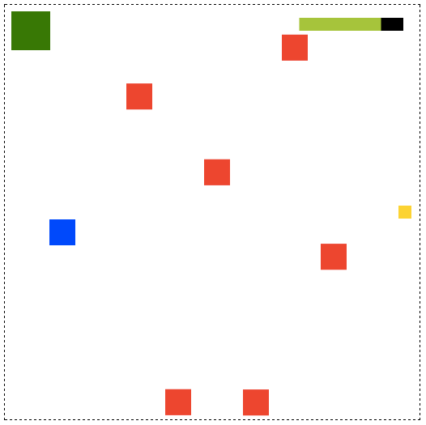
Treasure hunter enhanced

Slide 115
Groups
Group sprites together to make
compound sprites
//Create the health bar
var outerBar = g.rectangle(128, 16, "black"),
innerBar = g.rectangle(128, 16, "yellowGreen");
//Group the inner and outer bars
healthBar = g.group(outerBar, innerBar);
//Set the `innerBar` as a property of the `healthBar`
healthBar.inner = innerBar;
//Position the health bar sprite group
healthBar.x = g.canvas.width - 148;
healthBar.y = 16;

Slide 116
Use groups to create game scenes
//Create the `gameScene` group
gameScene = g.group();
//Create sprites and add them to the `gameScene`
player = g.rectangle(32, 32, “blue");
gameScene.addChild(player);
treasure = g.rectangle(16, 16, “gold");
gameScene.addChild(treasure);
healthBar = g.group(outerBar, innerBar);
gameScene.addChild(healthBar);
//Optionally group all sprites with at once like this:
gameScene.add(player, treasure, healthBar);
//Create text and add it to the `gameOverScene`
message = g.text("Game Over!", "64px Futura", "black", 20, 20);
gameOverScene = g.group(message);
gameOverScene.visible = false;

Slide 117
Hide or reveal game scenes as
you need them
//...
//Check for the end of the game
//Does the player have enough health? If the width of the `innerBar`
//is less than zero, end the game and display "You lost!"
if (healthBar.inner.width < 0) {
g.state = end;
message.content = "You lost!";
}
//If the player has brought the treasure to the exit,
//end the game and display "You won!"
if (g.hitTestRectangle(treasure, exit)) {
g.state = end;
message.content = "You won!";
}
}
function end() {
gameScene.visible = false;
gameOverScene.visible = true;
}

Slide 118
Convenience methods
`move` and `contain`
var playerHit = false;
enemies.forEach(function(enemy) {
//Move the enemy
g.move(enemy);
//Check the enemy's screen boundaries
var enemyHitsEdges = g.contain(enemy, g.stage.localBounds);
//If the enemy hits the top or bottom of the stage, reverse
//its direction
if (enemyHitsEdges === "top" || enemyHitsEdges === "bottom") {
enemy.vy *= -1;
}
//Test for a collision. If any of the enemies are touching
//the player, set `playerHit` to `true`
if(g.hitTestRectangle(player, enemy)) {
playerHit = true;
}
});

Slide 119
Keyboard controller
//arguments: thingToControl, speed, up, right, down, left
g.fourKeyController(player, 5, 38, 39, 40, 37);

Slide 120
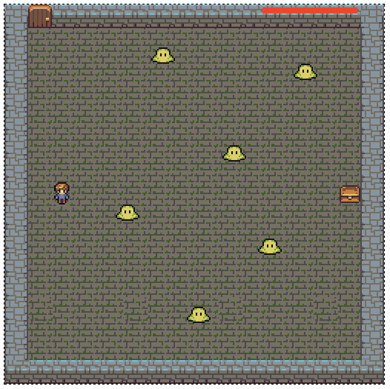
Adding images

Slide 121
Preload the images you want to use
var g = ga(
512, 512, setup,
[
"images/explorer.png",
"images/dungeon.png",
"images/blob.png",
"images/treasure.png",
"images/door.png",
"sounds/chimes.wav"
]
);
g.start();

Slide 122
Use the `sprite` method to create an
image sprite
//The dungeon background
dungeon = g.sprite("images/dungeon.png");
gameScene.addChild(dungeon);
//The exit door
exit = g.sprite("images/door.png");
exit.x = 32;
gameScene.addChild(exit);
//The player sprite
player = g.sprite("images/explorer.png");
player.x = 68;
player.y = g.canvas.height / 2 - player.height / 2;
gameScene.addChild(player);
//Create the treasure
treasure = g.sprite("images/treasure.png");
//Position it next to the left edge of the canvas
treasure.x = g.canvas.width - treasure.width - 32;
treasure.y = g.canvas.height / 2 - treasure.height / 2;

Slide 123
Fine tune the containment area
g.contain(
player,
{
x: 32, y: 16,
width: g.canvas.width - 32,
height: g.canvas.height - 32
}
);

Slide 124
You’re done!

Slide 125
Where now?
Decide what kind of games you want to make.
Explore tools that will help you make that game.
Use an existing game engine or build your own out of components.
Start designing a game for next year’s js13K competition.

Slide 126
Useful tools
Pixi: fast and easy 2D rendering engine
Babylon: 3D rendering engine for games
Howler: WebAudio sound library
Photon: Particle effects
Tween.js: Tween animation library
Better-than-average game engines: Phaser, Impact, Goo Engine, Unity, Play Canvas, Monogame

Slide 127
Useful resources
www.html5gamedevs.com
opengameart.org
www.universalsoundfx.com
Game development links: github.com/ellisonleao/magictools

Slide 128
Rich Davey’s tips
Things you’re told are not possible today might be by the end of the project.
Be prepared to un-learn what you know every 6 months.
Googling a problem? Check the dates of the answers. Disregard anything > 1 year old.

Slide 129
Bye for now!
www.kittykatattack.com
github.com/kittykatattack/ga
@rexvanderspuy
dandylion13@gmail.com
… and lots of books.

